Slide 1
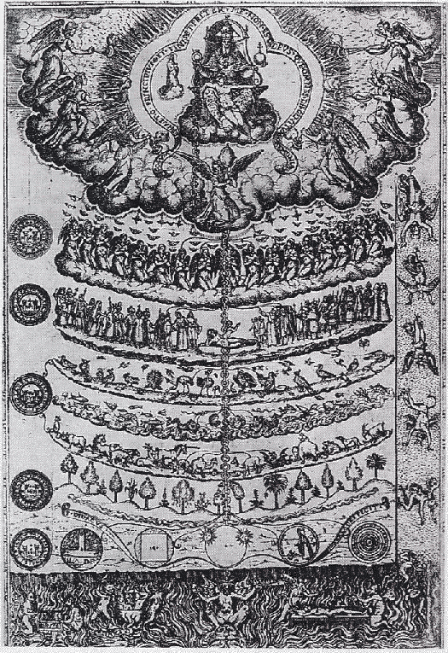
Scala Naturae
Being
God
Realm of Being
Angels
Demons
Man
1579 drawing of the Great Chain of Being from Didacus Valades, Rhetorica Christiana. Source Wikipedia
Animals
Realm of Becoming
Plants
Minerals
Non-being

Slide 2
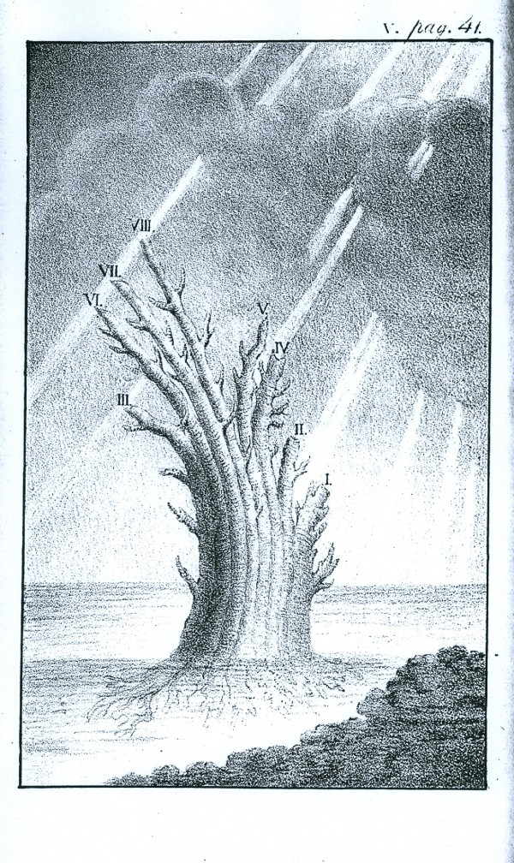
Russian naturalist Peter Simon Pallas (1766): "But the system of organic bodies is best of all represented by an image of a tree which immediately from the root would lead forth out of the most simple plants and animals a double, variously contiguous animal and vegetable trunk; the ﬁrst of which would proceed from mollusks to ﬁshes, with a large side branch of insects sent out between these, hence to amphibians and at the farthest tip it would sustain the quadrupeds, but below the quadrupeds it would put forth birds as an equally large side branch.” (translation from Latin by E. N. Genovese, from J. David Archibald: "Edward Hitchcock’s Pre-Darwinian (1840) ‘Tree of Life’" Journal of the History of Biology (2009) 42:561–592)
Tree of animal life, Depiction of the tree proposed by Peter Simon Pallas, from Carl Edward von Eichwald's Zoologia specialis (1829). (From: Mark A. Ragan: "Trees and networks before and after Darwin", Biol Direct. 2009 Nov 16;4:43.)

Slide 3
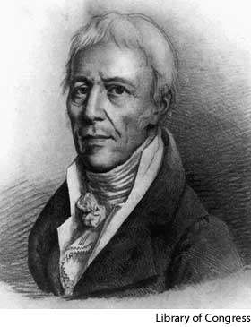
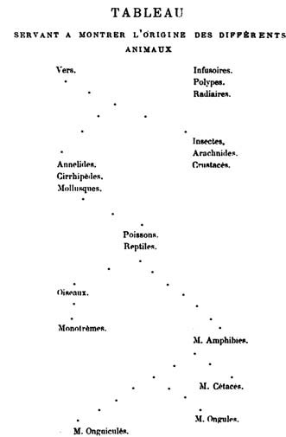
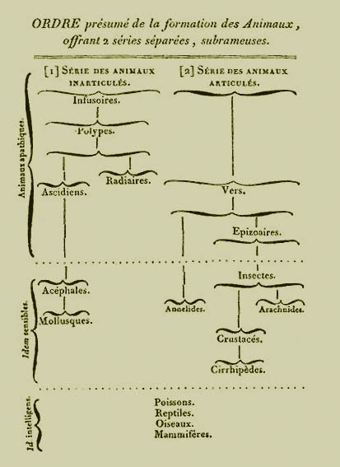
Jean-Baptiste Lamarck
Tree from 1809
Tree-like classification from 1815

Slide 4
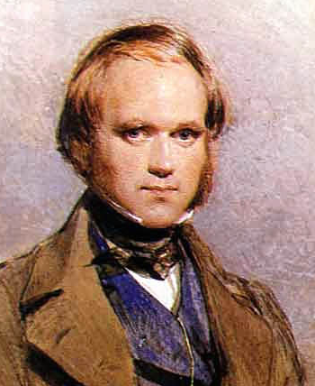
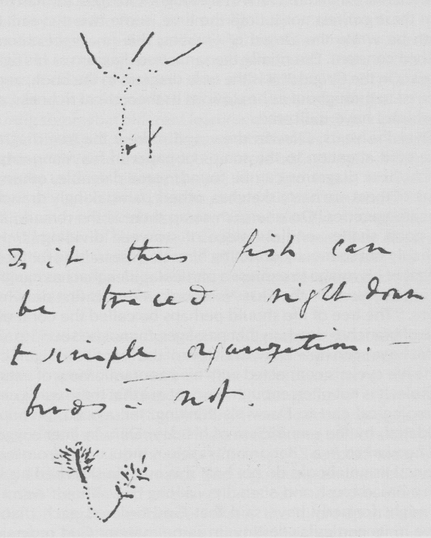
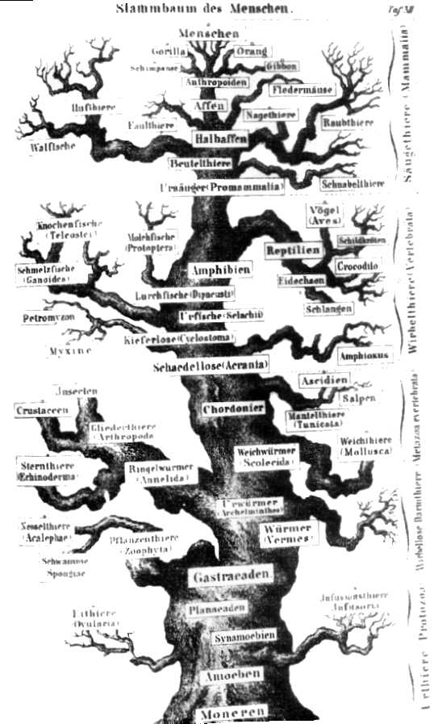
Charles Darwin, 1830s (by G. Richmond from
Origins, Richard Leakey and Roger Lewin
sourcecommons.wikimedia.org )
Sketch from Charles Darwin’s (1809-1882) notebook (1837)
Lebensbaum from Ernst Haeckel, 1874

Slide 5
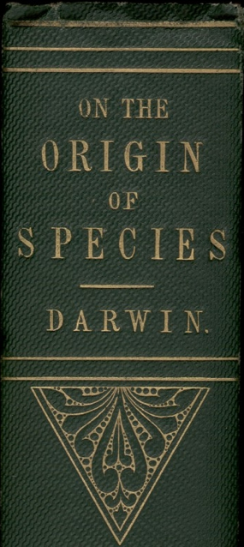
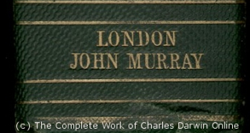
“As buds give rise by growth to fresh buds, and these, if vigorous, branch out and overtop on all sides many a feebler branch, so by generation I believe it has been with the great Tree of Life, which fills with its dead and broken branches the crust of the earth, and covers the surface with its ever-branching and beautiful ramifications.”
Charles Darwin in “On the Origin of Species by Means of Natural Selection or the Preservation of Favoured Races in the Struggle for Life”, p 162 ff, London, John Murray, 1859

Slide 6
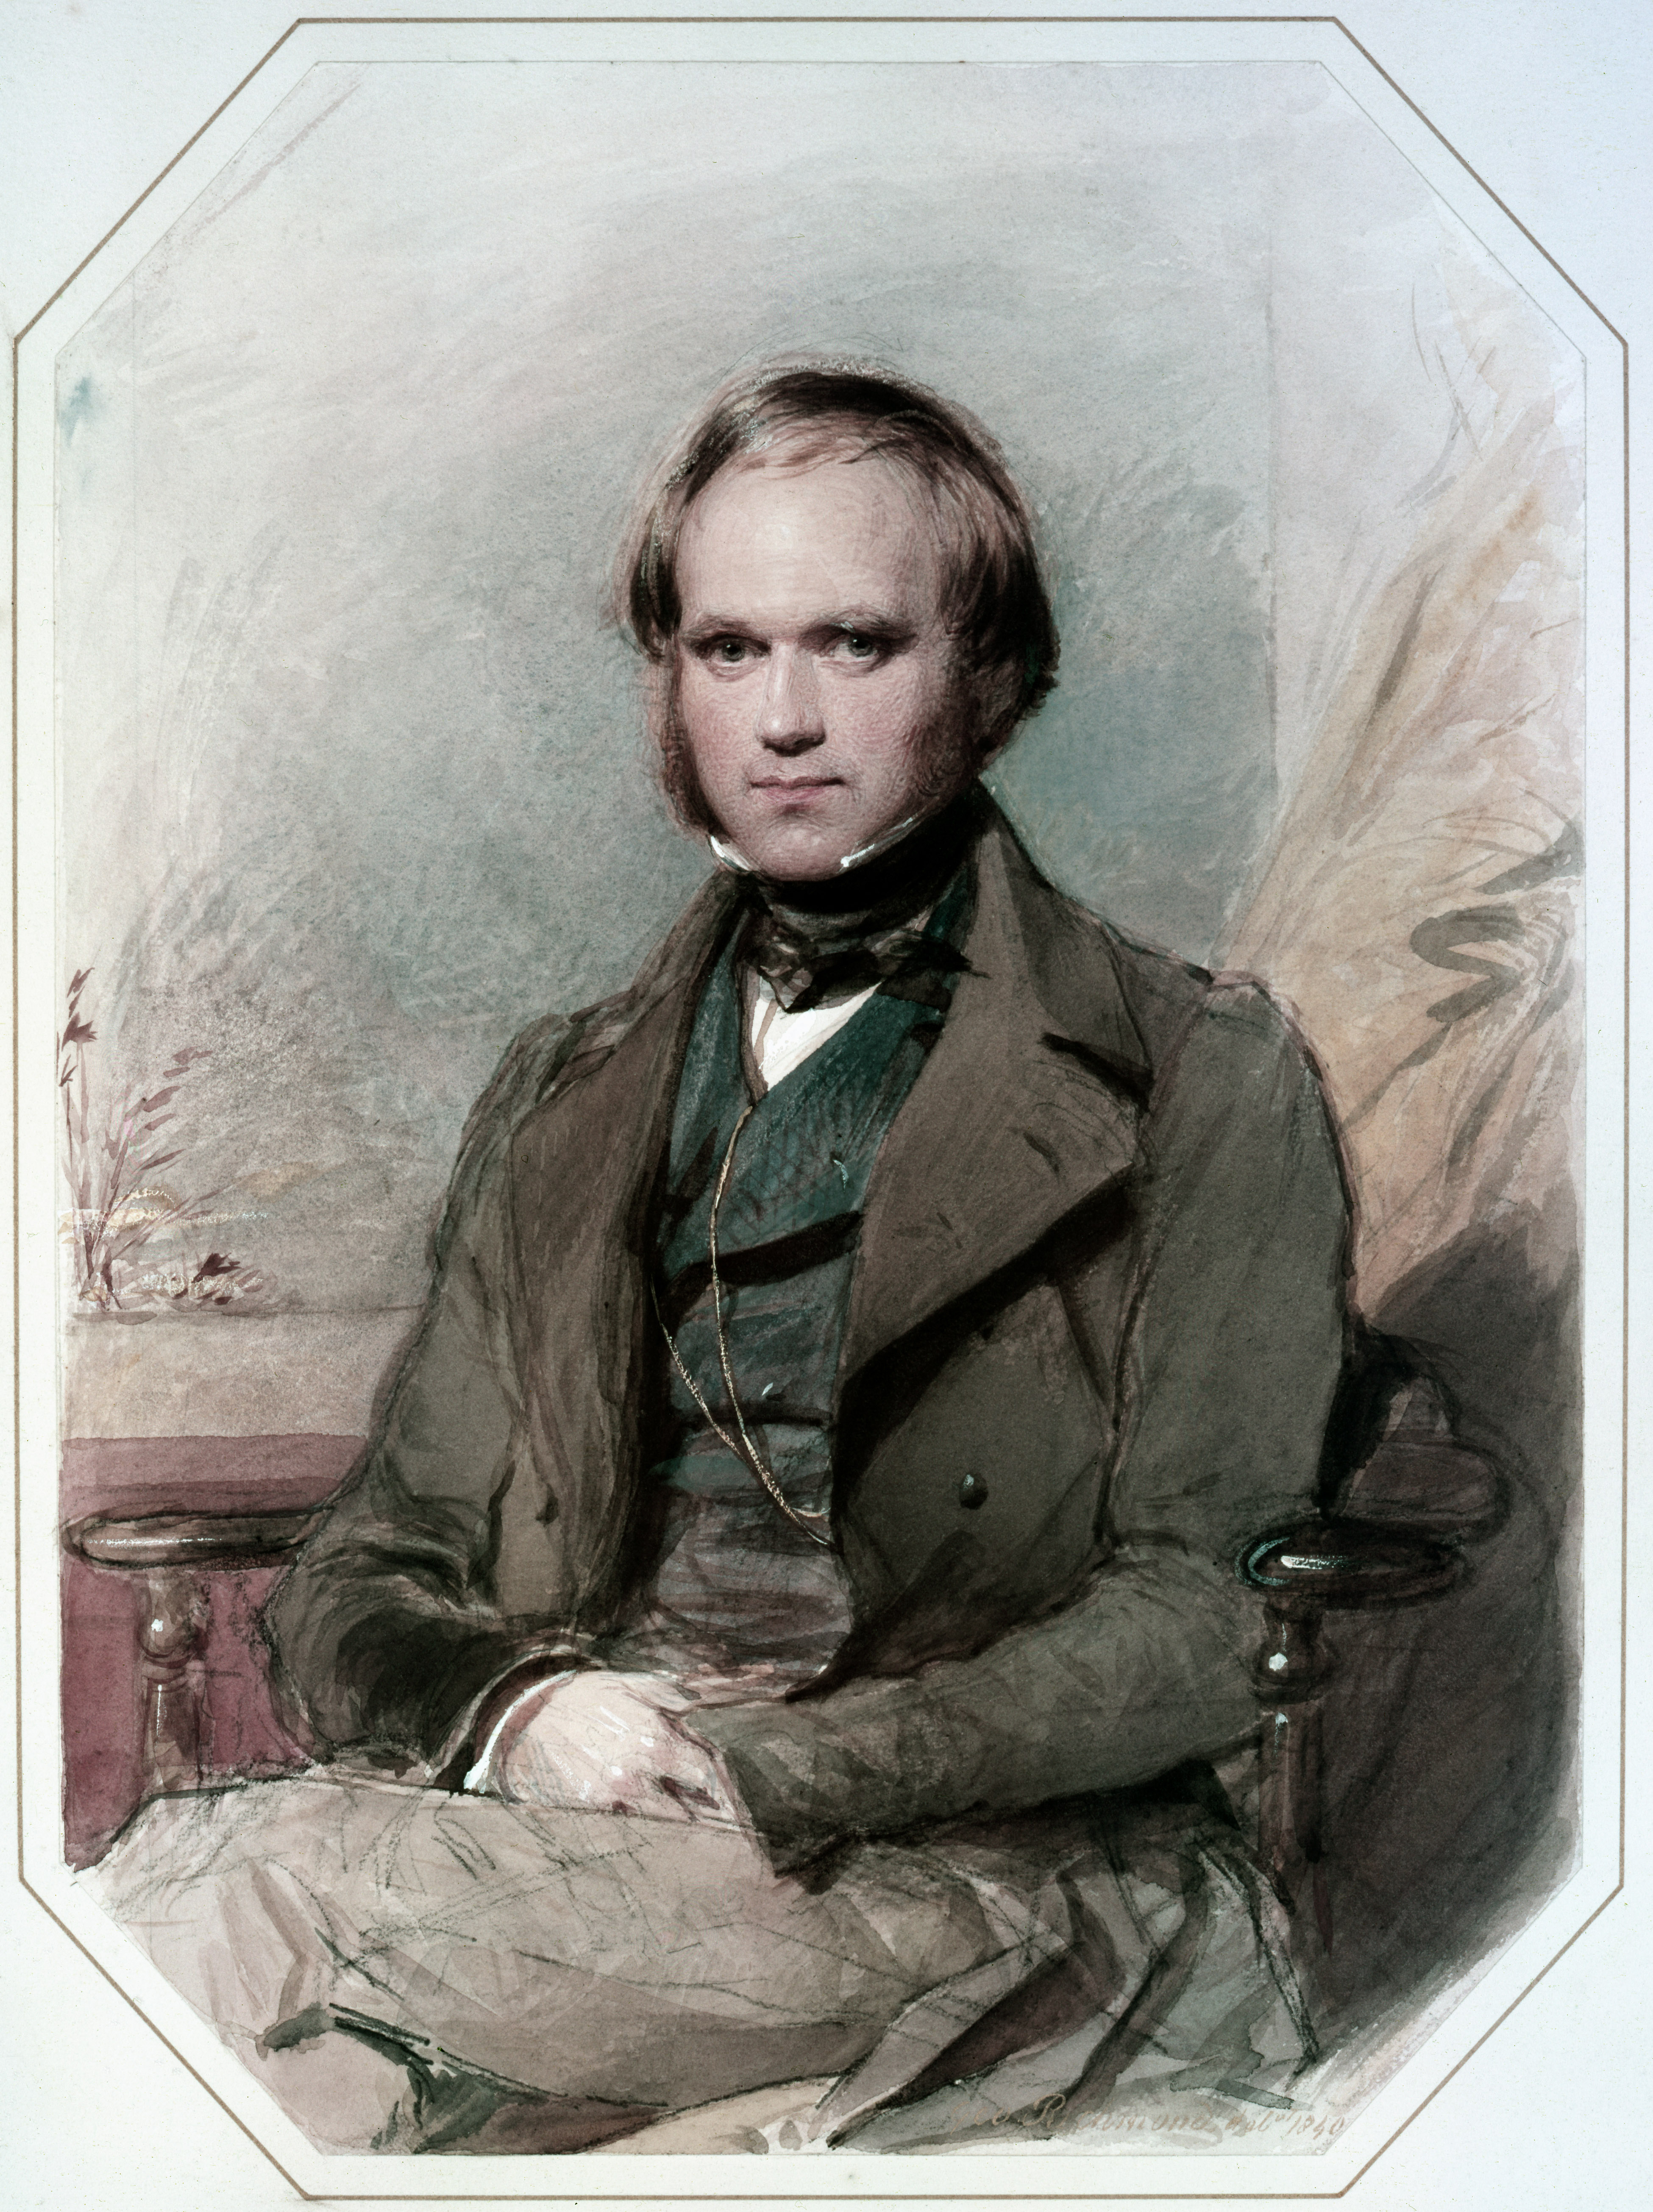
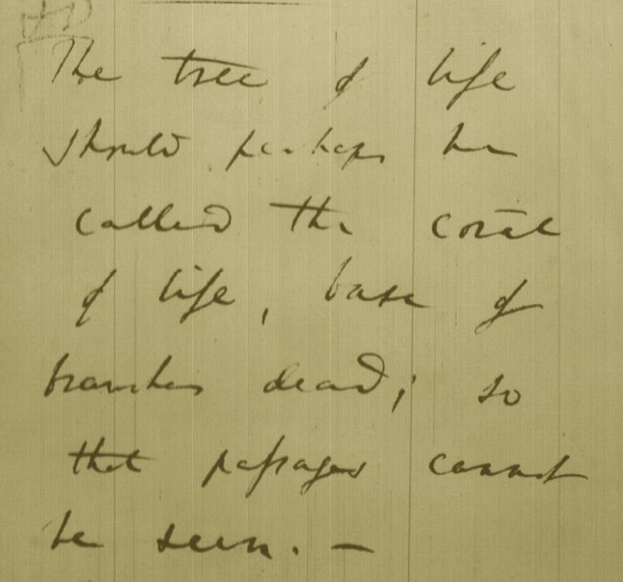
Tree, Web, or Coral of Life?
“The tree of life should perhaps be called the coral of life, base of branches dead”
Charles Darwin
painted by George Richmond in the late 1830
Page B26 from Charles Darwin’s (1809-1882) notebook (1837/38)

Slide 7
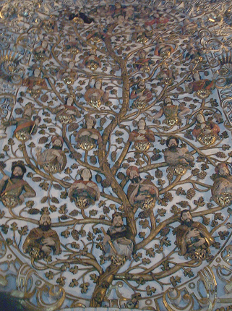
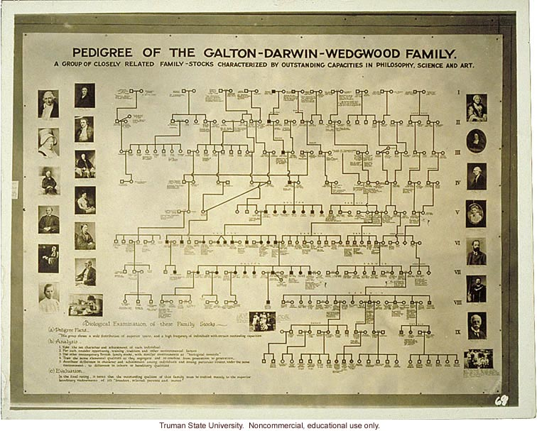
Family Trees, Genealogies, Pedigrees
Genealogy (Church Ceiling, Santo Domingo, Oaxaca)
Charles Darwin's Family "Tree"

Slide 8
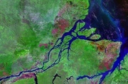
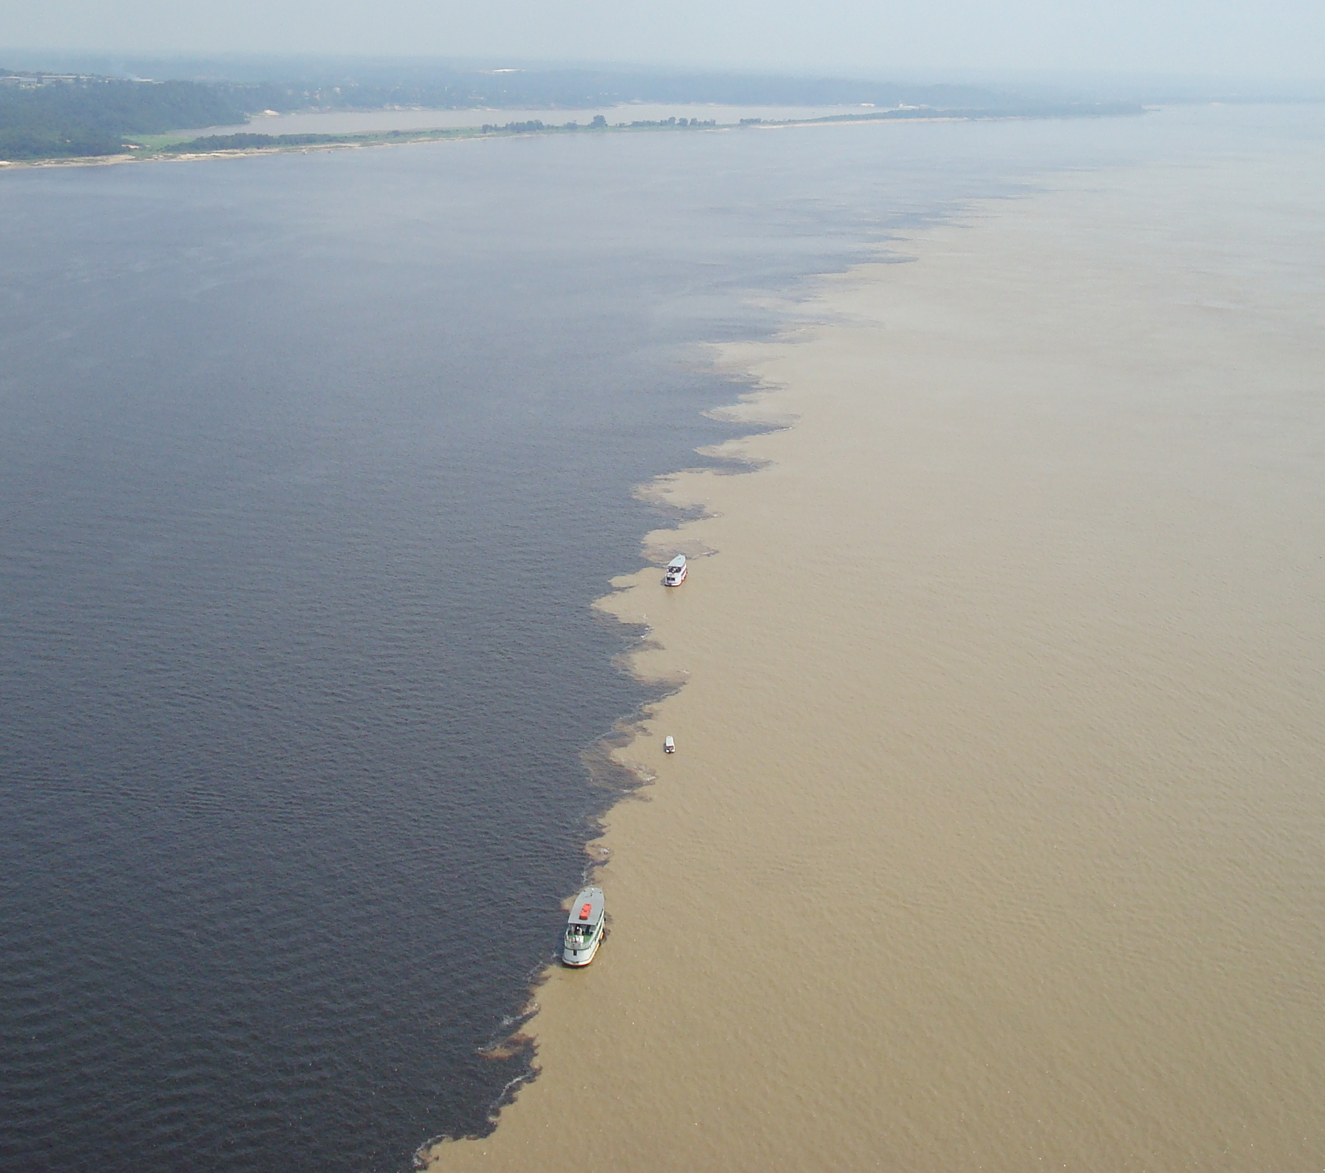
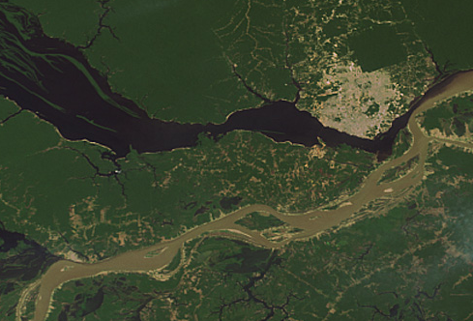
The Watershed of Life
Jonathan Eisen in his Tree of Life Blog on "Top Five Metaphors Charles Darwin Considered"
http://phylogenomics.blogspot.com/2008/06/top-five-metaphors-darwin-considered.html
http://www.southcom.mil/appssc/files/Blogs/633600980055909252.jpg
Meeting of the meeting of Solimões and Negro rivers at Origin of the Amazon

Slide 9
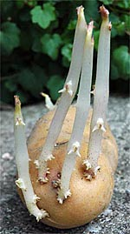
THE POTATO OF LIFE
Bacteria
Archaea
Eukaryotes
Successive independent crystallization of the three domains of life from a population of pre-cells
extinct
lineage
Glansdorff N, Xu Y, Labedan B: The Last Universal Common Ancestor: emergence, constitution and genetic legacy of an elusive forerunner. Biol Direct 2008, 3:29.
Kandler O (1994) The early diversification of life. In Early Life on Earth, Nobel Symposium, vol. 84, pp. 152-509: Columbia Univ. Press.
Woese CR (2002) On the evolution of cells. PNAS 99: 8742-7
photo from www.sonnentaler.net

Slide 10
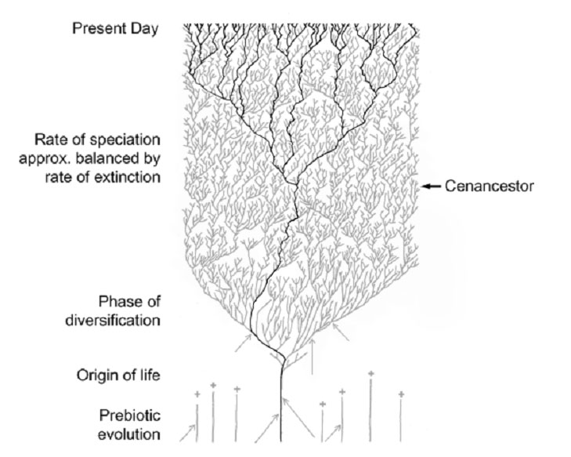
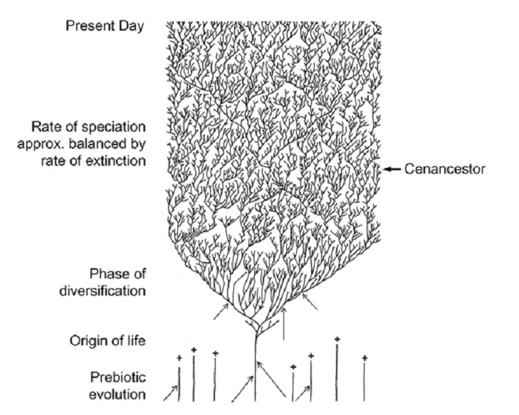
The Coral of Life (Darwin)
ZHAXYBAYEVA and GOGARTEN (2004):
Cladogenesis, Coalescence and the Evolution of the Three Domains of Life.
Trends in Genetics 20 (4): 182- 187
Notes:
The “Coral of Life” and the transfer of characters from now extinct into surviving lineages

Slide 11
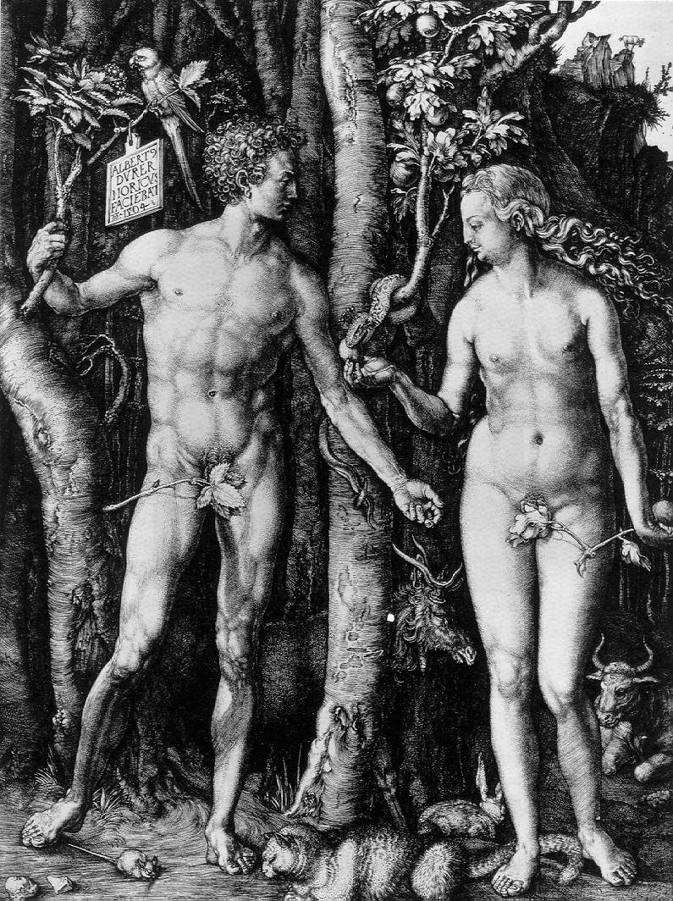
Y chromosome
Adam
Mitochondrial
Eve
Lived
approximately
40,000 years ago
Lived
166,000-249,000
years ago
Thomson, R. et al. (2000) Proc Natl Acad Sci U S A 97, 7360-5
Underhill, P.A. et al. (2000) Nat Genet 26, 358-61
Mendez et al. (2013) American Journal of Human Genetics 92 (3): 454.
Cann, R.L. et al. (1987) Nature 325, 31-6
Vigilant, L. et al. (1991) Science 253, 1503-7
Albrecht Dürer, The Fall of Man, 1504
Adam and Eve never met ☹
The same is true for ancestral rRNAs, EF, ATPases!

Slide 12
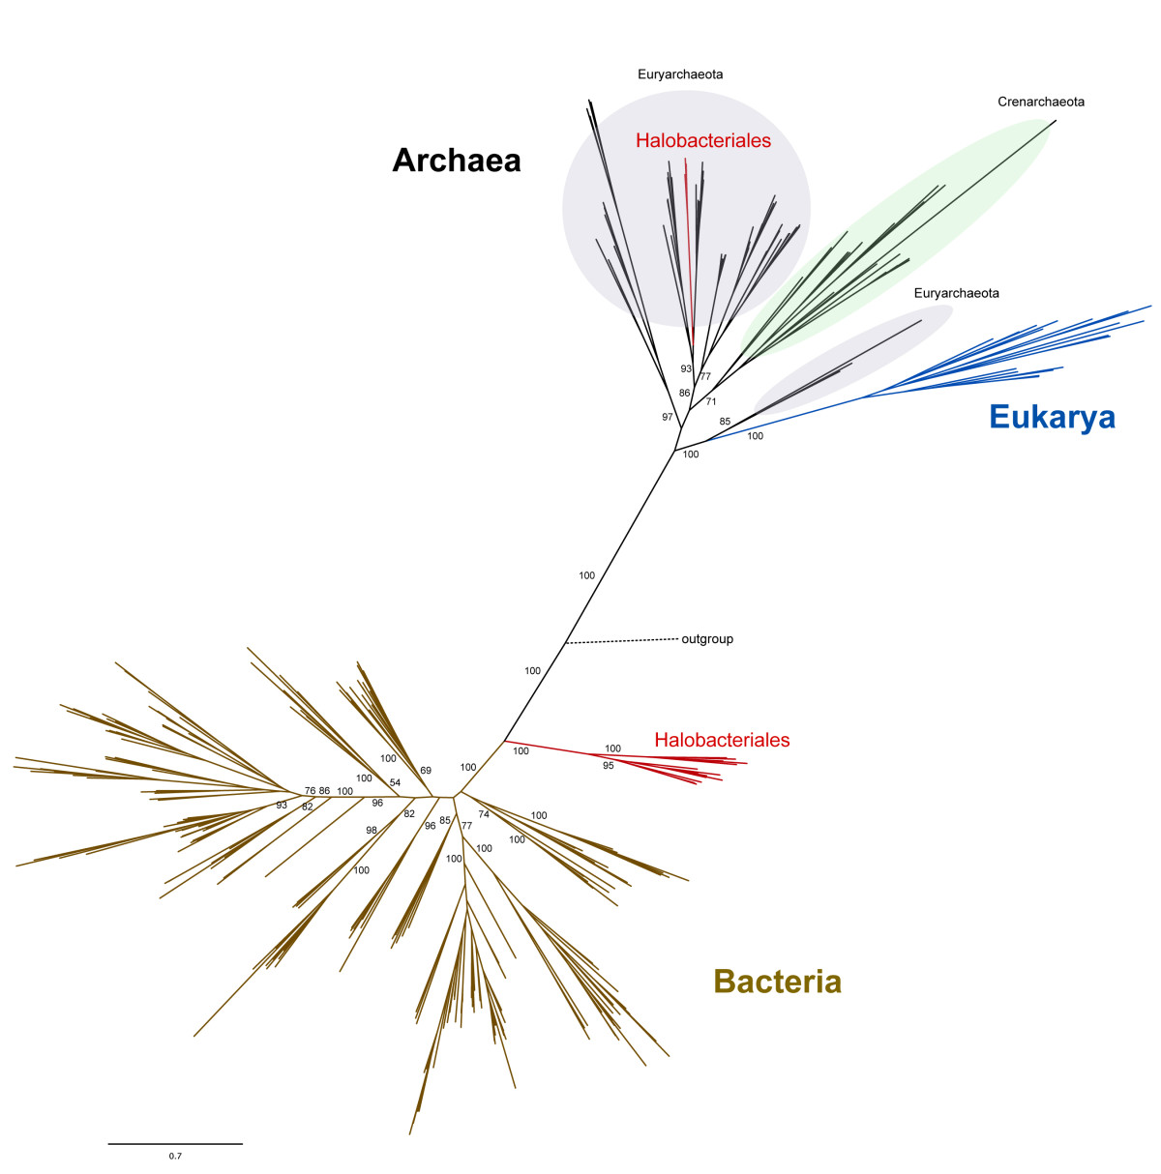
leucyl-tRNA synthetase phylogeny
Ancient origin of the divergent forms of leucyl-tRNA synthetases in the Halobacteriales
Cheryl P Andam, Timothy J Harlow, R Thane Papke and J Peter Gogarten
BMC Evolutionary Biology 12:85

Slide 13
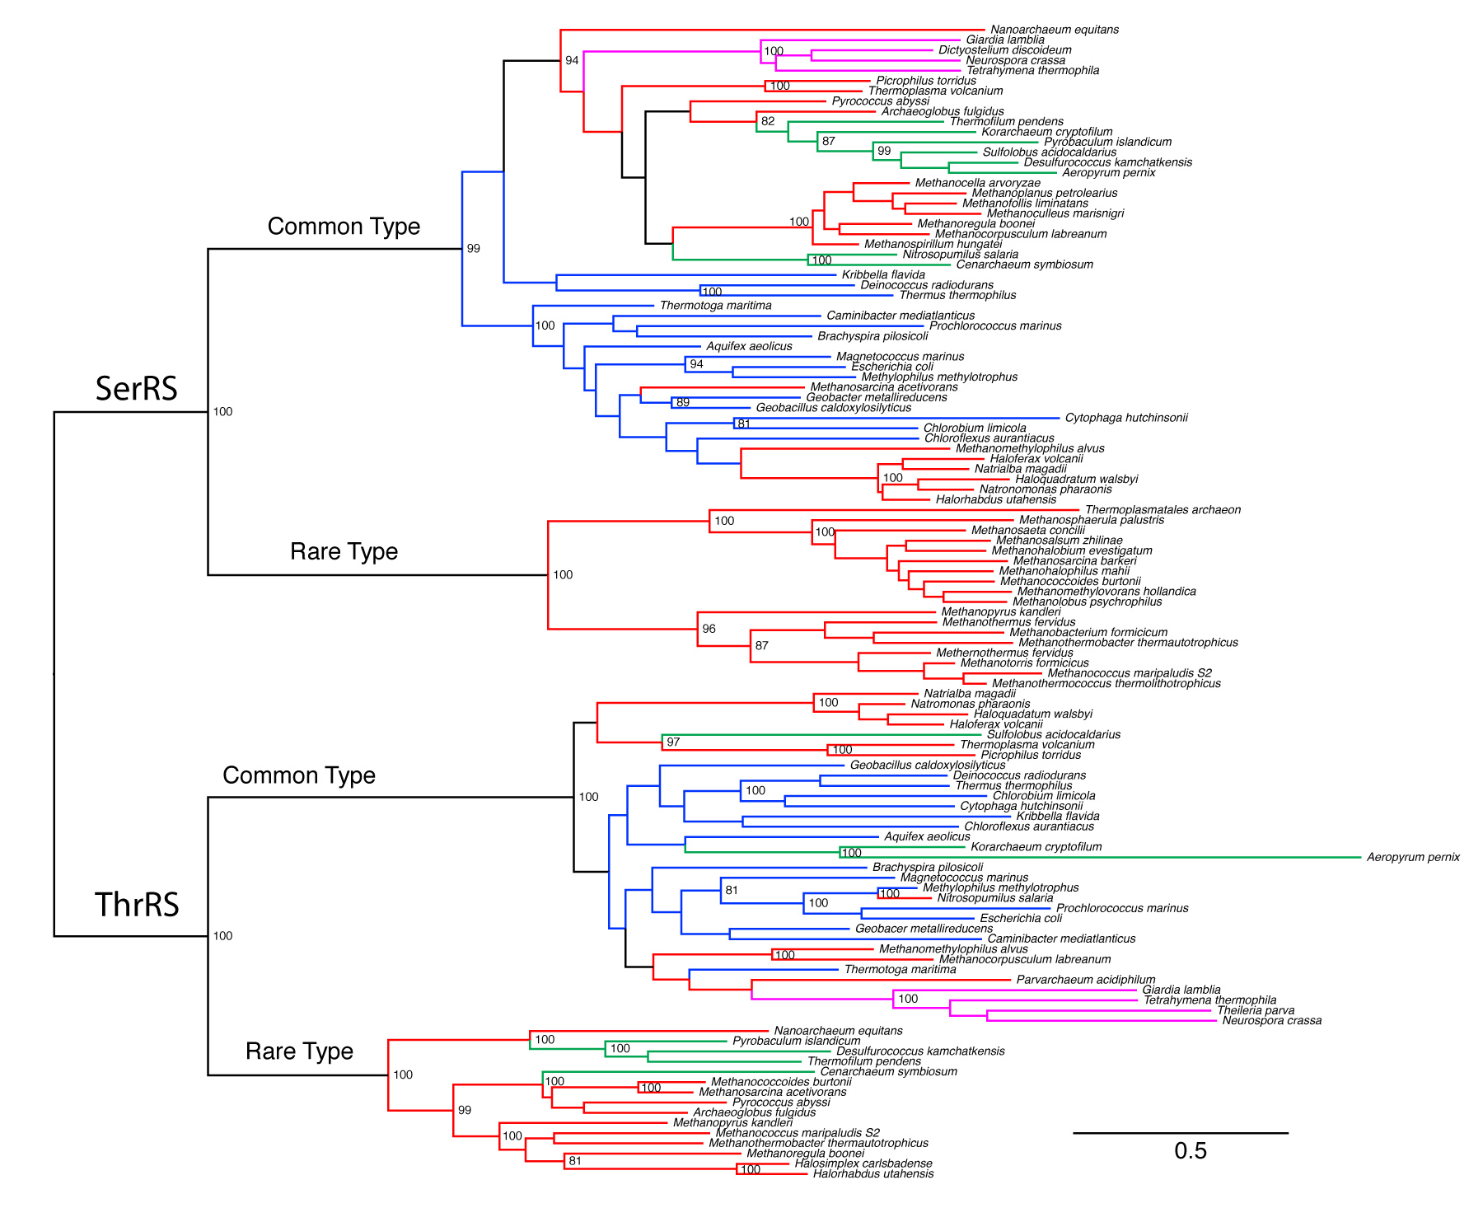
thrRS and serRS phylogeny
Eukaryotes
Crenarchaeota
Euryachaeota
Bacteria
Alignment with PRANK and SATé, tree with phyml (WAG, gamma +I)

Slide 14
Gene Transfer and Phylogenetic Reconstruction: Friends or Foes?
Popular view
Gene transfer is a disruptive force in phylogenetic reconstruction.
New view
Events of ancient gene transfer are valuable tools for reconstructing organismal phylogeny.

Slide 15
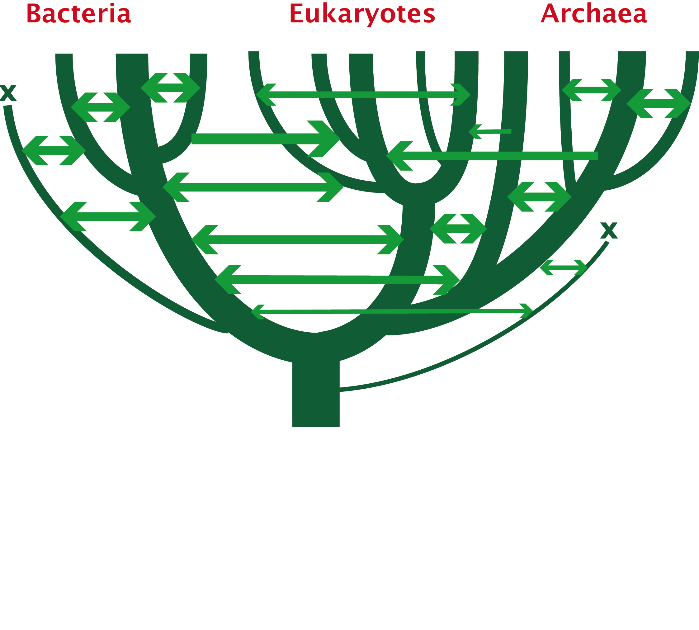
1. Any ancient gene transfer to the ancestor of a major lineage implicitly marks the recipient and descendents as a natural group.
2. The donor must exist at the same time or earlier than the recipient.
Ancient HGTs

Slide 16
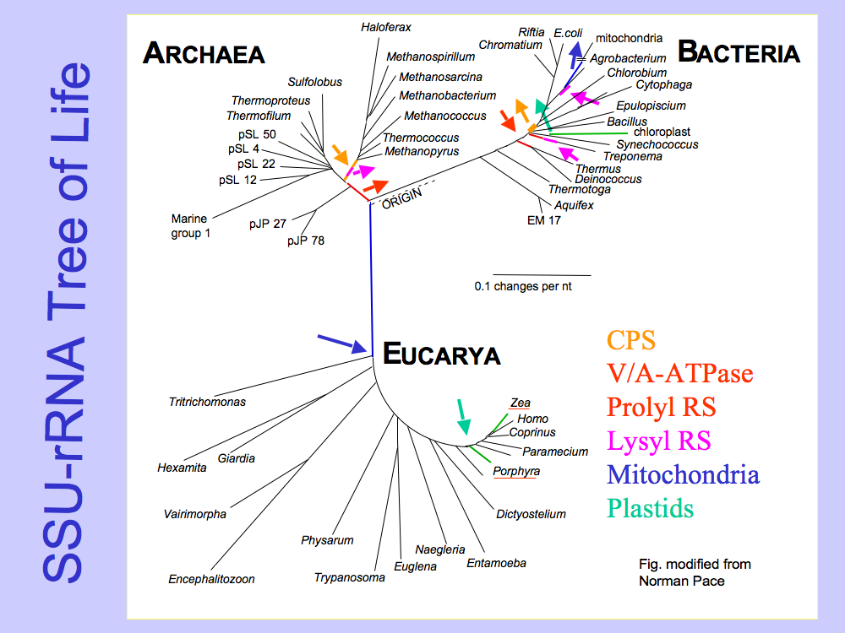
Small subunit ribosomal RNA (16S) based tree of life.
Carl Woese, George Fox, and many others.

Slide 17
Presence of a transferred gene is a shared derived character that can be useful in systematics.
Gene “ping-pong” between different lineages can be used to build correlations between different parts of the tree/net of life.
Notes:
Gene ping pong
Fossil record for the early evolution is sparse -- gene transfer allows to use marker from one group also for other groups
Tyrosyl tRNA synthetase

Slide 18
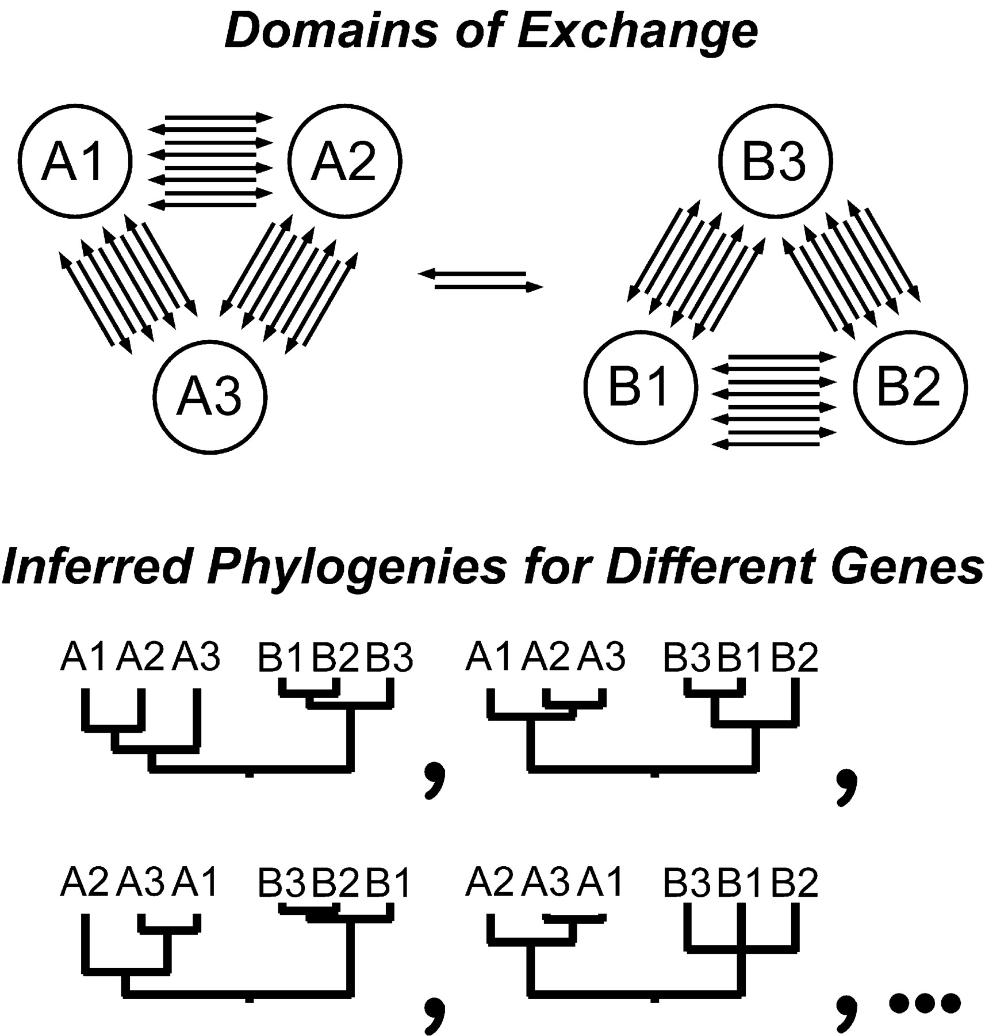
HGT can generate reproducible patterns in molecular phylogenies.
Gogarten, J.P., Doolittle, W.F., Lawrence, J.G., Mol. Biol. Evol. 2002 19:2226-2238.

